Slide 1
Team_1(Blue_Pr0s)
Bahaa Boghdady Kamel
Eslam El-Sayed Abdelhadi
Mohsen Sabry Abdelmohsen
Youssef Nabil Youssef
Mentor : Eng/ Marina Hany

Slide 2
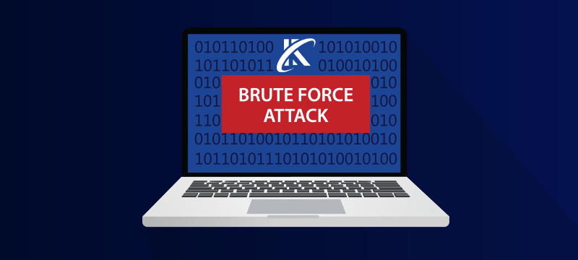
Brute Force Attack: Definition, Mechanism, and Solutions

Slide 3
Introduction
What is a Brute Force Attack?
It is a cyber-attack technique aimed at cracking passwords or gaining access to systems by trying all possible combinations until the correct one is found.

Slide 4
Definition of Brute Force Attack
A Brute Force Attack involves:
- Trying all possible combinations of passwords or keys until the correct one is found.
- It relies on computational power rather than exploiting software vulnerabilities.

Slide 5
Mechanism of Brute Force Attack
1. Target Identification: Identifying a target system (e.g., user accounts or encrypted data).
2. Information Gathering: Understanding the system and its authentication methods.
3. Launching the Attack: Automated tools try all possible combinations.
4. Success: Once the correct combination is found, the attacker gains access.

Slide 6
Types of Brute Force Attacks
1. Simple Brute Force Attack: Tries all possible combinations.
2. Dictionary Attack: Uses a pre-built list of common or likely passwords.
3. Advanced Brute Force Attack: Uses statistical analysis to prioritize likely combinations.

Slide 7
Examples of Brute Force Attacks
- Cracking user account passwords (e.g., email or social media accounts).
- Decrypting data (e.g., files protected by strong passwords).
- Breaking into networks by trying Wi-Fi keys.

Slide 8
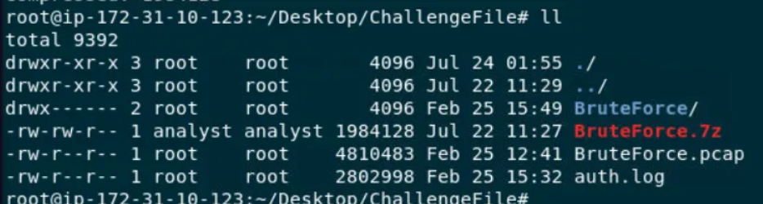
Start Investigation
Start investigations to know What is IP address of the server targeted
By the attacker’s brute-force attack

Slide 9
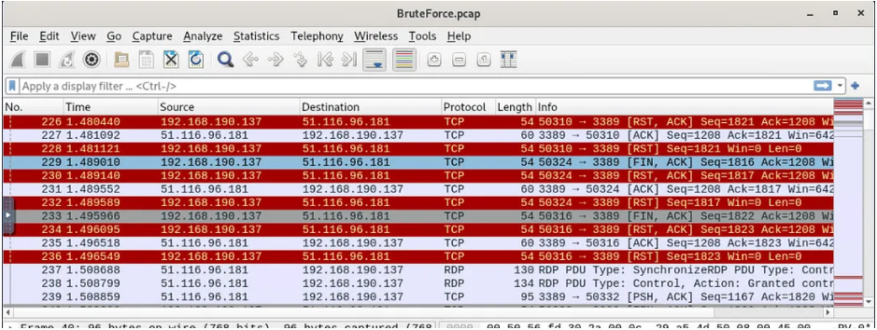
We got 2 artifacts that could be used which are pcap file and authentication log

Slide 10
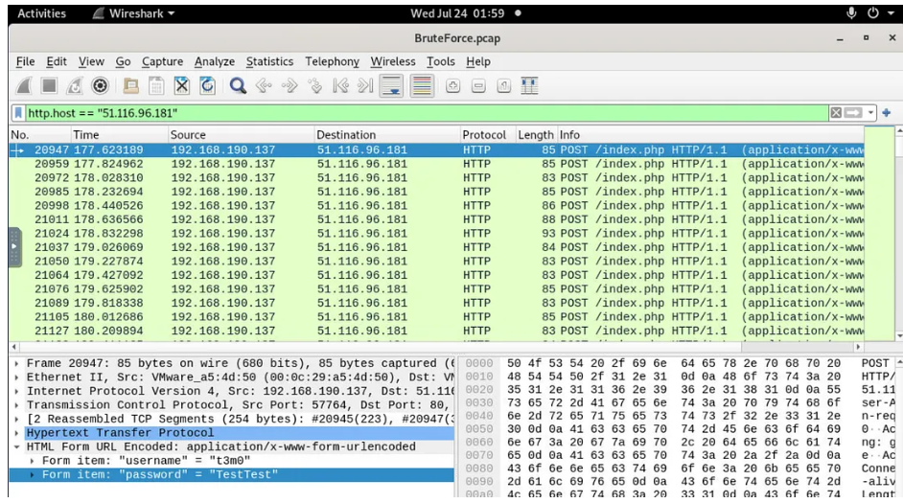
we could notice is that there are multiple RDP connection from this specific IP address to private IP address which should be the webserver that we got this network capture file from

Slide 11
When filtered for the external IP address which revealing another story, turns out that this external IP address is a webserver and it was also bruteforced to get access via login page
The IP 51.116.96.181
directory was targeted by the attacker’s brute-force attempt
Index.php

Slide 12
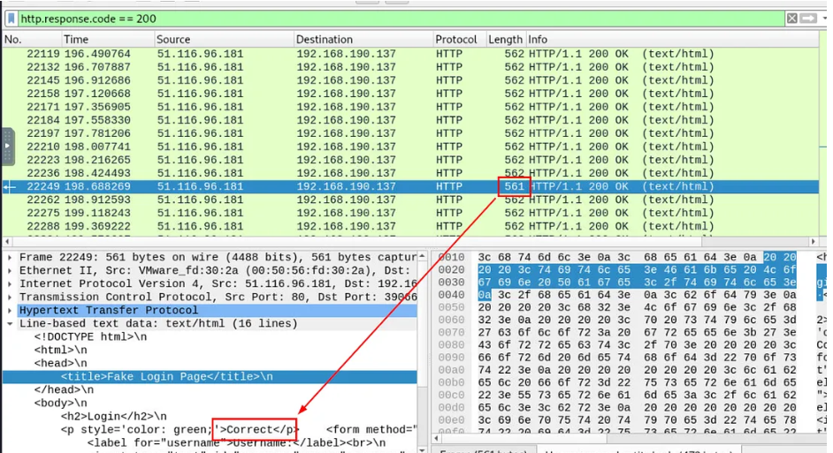
We tried to filter for HTTP response code 302 (Redirected) which most of website will be redirected to dashboard or another webpage after successfully logged on but there is no HTTP 302 here so I tried to identify which would be the different between successful logged on attempt and failed logon attempt

Slide 13
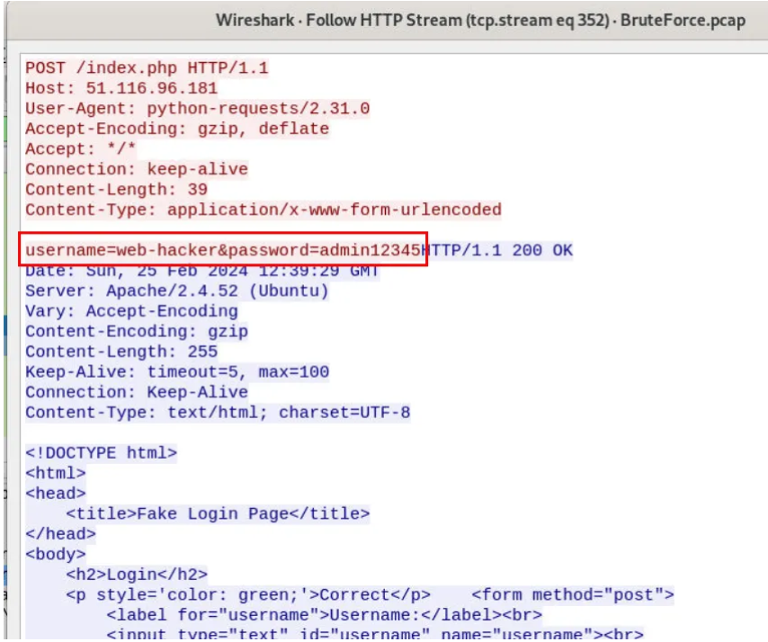
we can see that this HTTP response got 1 less bytes than the rest and when we inspected it then we could it that this attempt was successful

Slide 14
And here is the valid credentials that was accepted on this webserver
web-hacker:admin12345

Slide 15
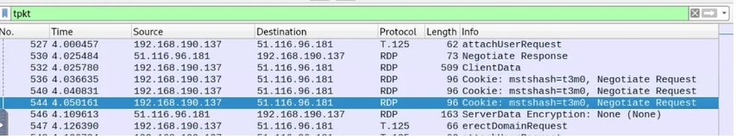
The users accounts did the attacker attempt to compromise via RDP brute-force

Slide 16
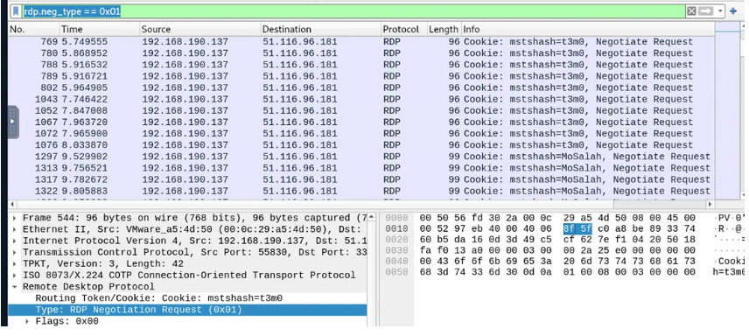
After filtered for rdp, we can see that there is user account name on Negotiation Request so we can use this information to get all users that was requested from this IP address

Slide 17
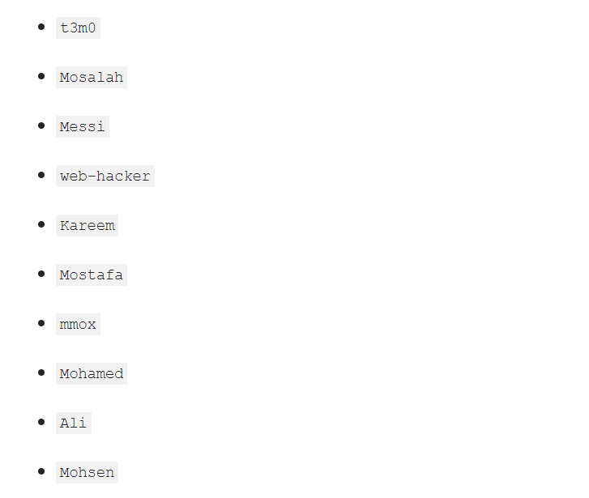
By using rdp.neg_type == 0x01, we can determine 10 unique users that sent negotiation request which are
7 Users That got bruteforced

Slide 18
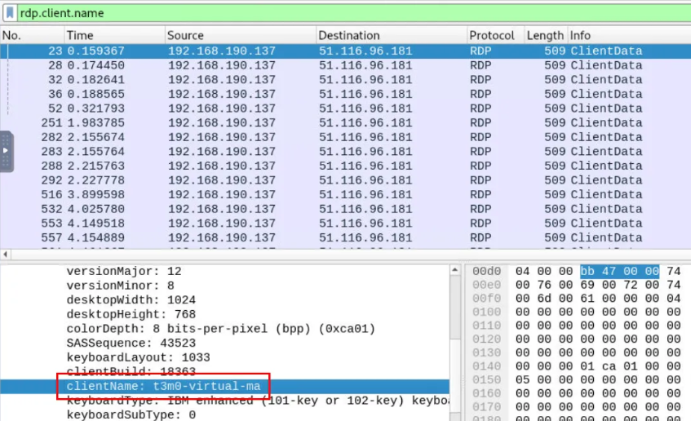
To Know What is the “clientName” of the attacker’s machine

Slide 19
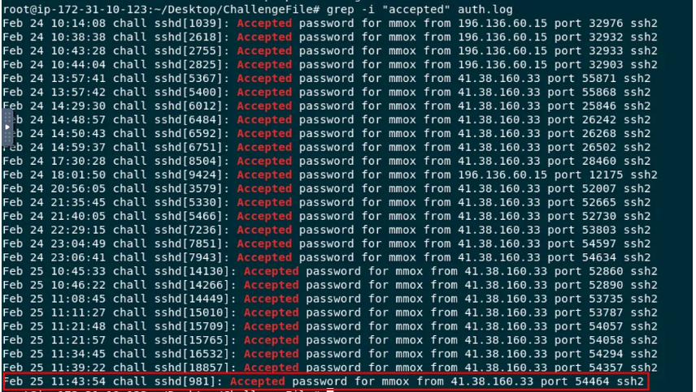
To Know When did the user last successfully log in via SSH, and who was its

Slide 20
Impact of Brute Force Attacks
1. There was a temporary disruption of services due to the heightened security measures.
Although no data was compromised, the incident highlighted the vulnerability of weak password policies.
The organization faced potential reputational damage had the attack been successful.

Slide 21
Root Cause Analysis
Default credentials on the targeted systems.
This vulnerability stemmed from the absence of strong password policies.
The lack of multi-factor authentication (MFA) on critical systems.
The reliance on simple, easily guessable passwords left the systems highly susceptible to attack.

Slide 22
How to Avoid Brute Force Attacks?
You can find some best practices for passwords below:
Never use information that can be found online (like names of family members).
Have as many characters as possible.
Combine letters, numbers, and symbols.
Minimum 8 characters.
Each user account is different.
Avoid common patterns.

Slide 23
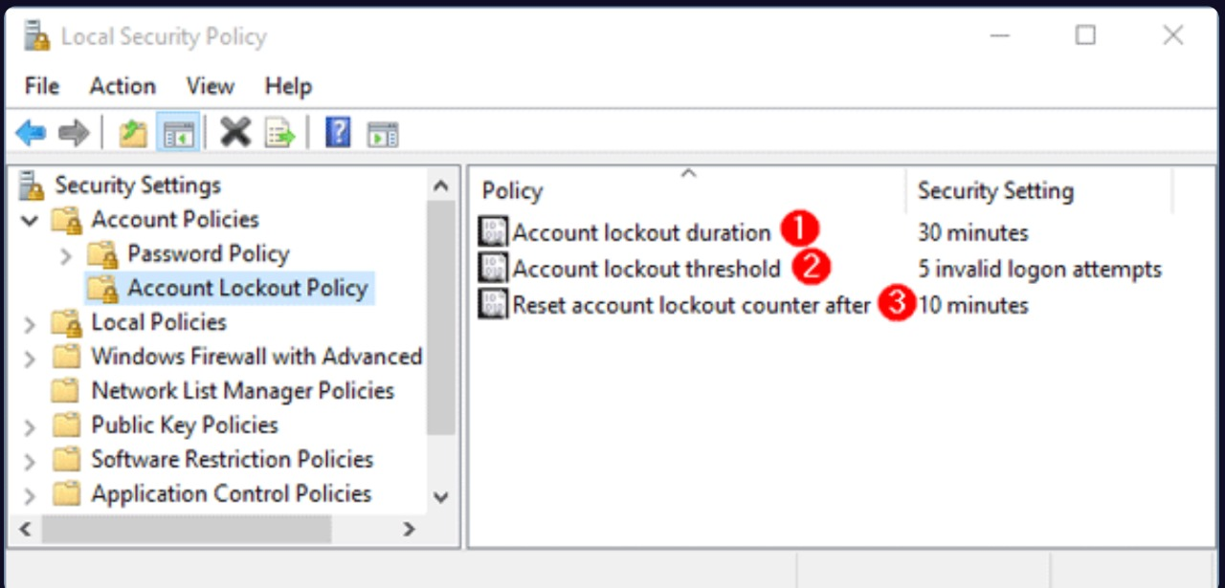
Here are some ways you can protect users from brute-force attacks as administrators of an organization:
Lock Policy - After a certain number of failed login attempts, you can lock accounts and then unlock them as an administrator.

Slide 24
Containment and Eradication
Implemented IP blocking for the attacker’s IP address (192.168190.137).
Firewall rules were updated to restrict suspicious login attempts.
To contain the threat, rate-limiting was applied on the SSH service to mitigate brute-force attempts.
In the eradication phase, a comprehensive audit of system logs ensured no unauthorized access occurred.

Slide 25
Recovery
1- Account recovery:
Restored all compromised accounts and ensured system integrity , followed by the re-deployment of secure backups for the web server.
2- System recovery:
Recovery efforts included restoring normal operations by securing all systems, implementing enhanced monitoring, and rolling out mandatory password resets across the organization.

Slide 26
Lessons Learned
1. Password Policies
2. Multi-Factor Authentication (MFA)
3. Monitoring and Detection
4. Incident Response Plan
5. Security Awareness Training

Slide 27
Conclusion
Key Takeaways:
- Brute Force Attack is a method of gaining unauthorized access by trying all possible combinations.
- It can cause financial, reputational, and security damage.
- Preventative measures like strong passwords, 2FA, and login limits are critical.
Apply security best practices to protect systems and data.

Slide 28
Thank you

